Slide 1


YouTube Song Analysis with Tableau
By adediran david

Slide 2
Overview
The goal of this project is to utilize Tableau to create insightful visualizations and reports that provide a deeper understanding of YouTube songs' performance, popularity, and user engagement. The analysis aims to uncover trends, preferences, and patterns in the data to aid content creators and stakeholders in optimizing their YouTube song content.
The dataset contains key attributes such as video ID, channel title, title, description, tags, published date, view count, like count, favorite count, comment count, video duration, video definition, and caption details.
video_id: Unique identifier for each YouTube video.
channelTitle: Title of the YouTube channel publishing the song.
title: Title of the YouTube song video.
description: Description provided for the YouTube song video.
tags: Tags associated with the YouTube song video.
publishedAt: Date and time when the YouTube song video was published.
viewCount: Number of views received by the YouTube song video.
likeCount: Number of likes received by the YouTube song video.
favoriteCount: Number of times the YouTube song video has been marked as a favorite.
commentCount: Number of comments posted on the YouTube song video.
duration: Duration of the YouTube song video.
definition: Video definition or quality (e.g., HD, SD).
caption: Availability of captions for the YouTube song video

Slide 3
Data cleaning and Preparation
The dataset was explored blanks, nulls, outliers and missing values.
Blanks were taken out. Videos with zero views and high likes were dropped.
Columns without a video title and other values necessary were also dropped.
Relevant columns were converted to the right data type.
‘Published At’ column was split into two : Published date and Published Time and the columns were converted into the right data type.
Data is ready for analysis and visualization.
Interact with the Dashboard Here : Youtube Dashboard and see each song videos engagement

Slide 4
Key Findings
Total views
230,945,654,850
Total Likes
1,686,525,216
Total Videos
19,336

Slide 5
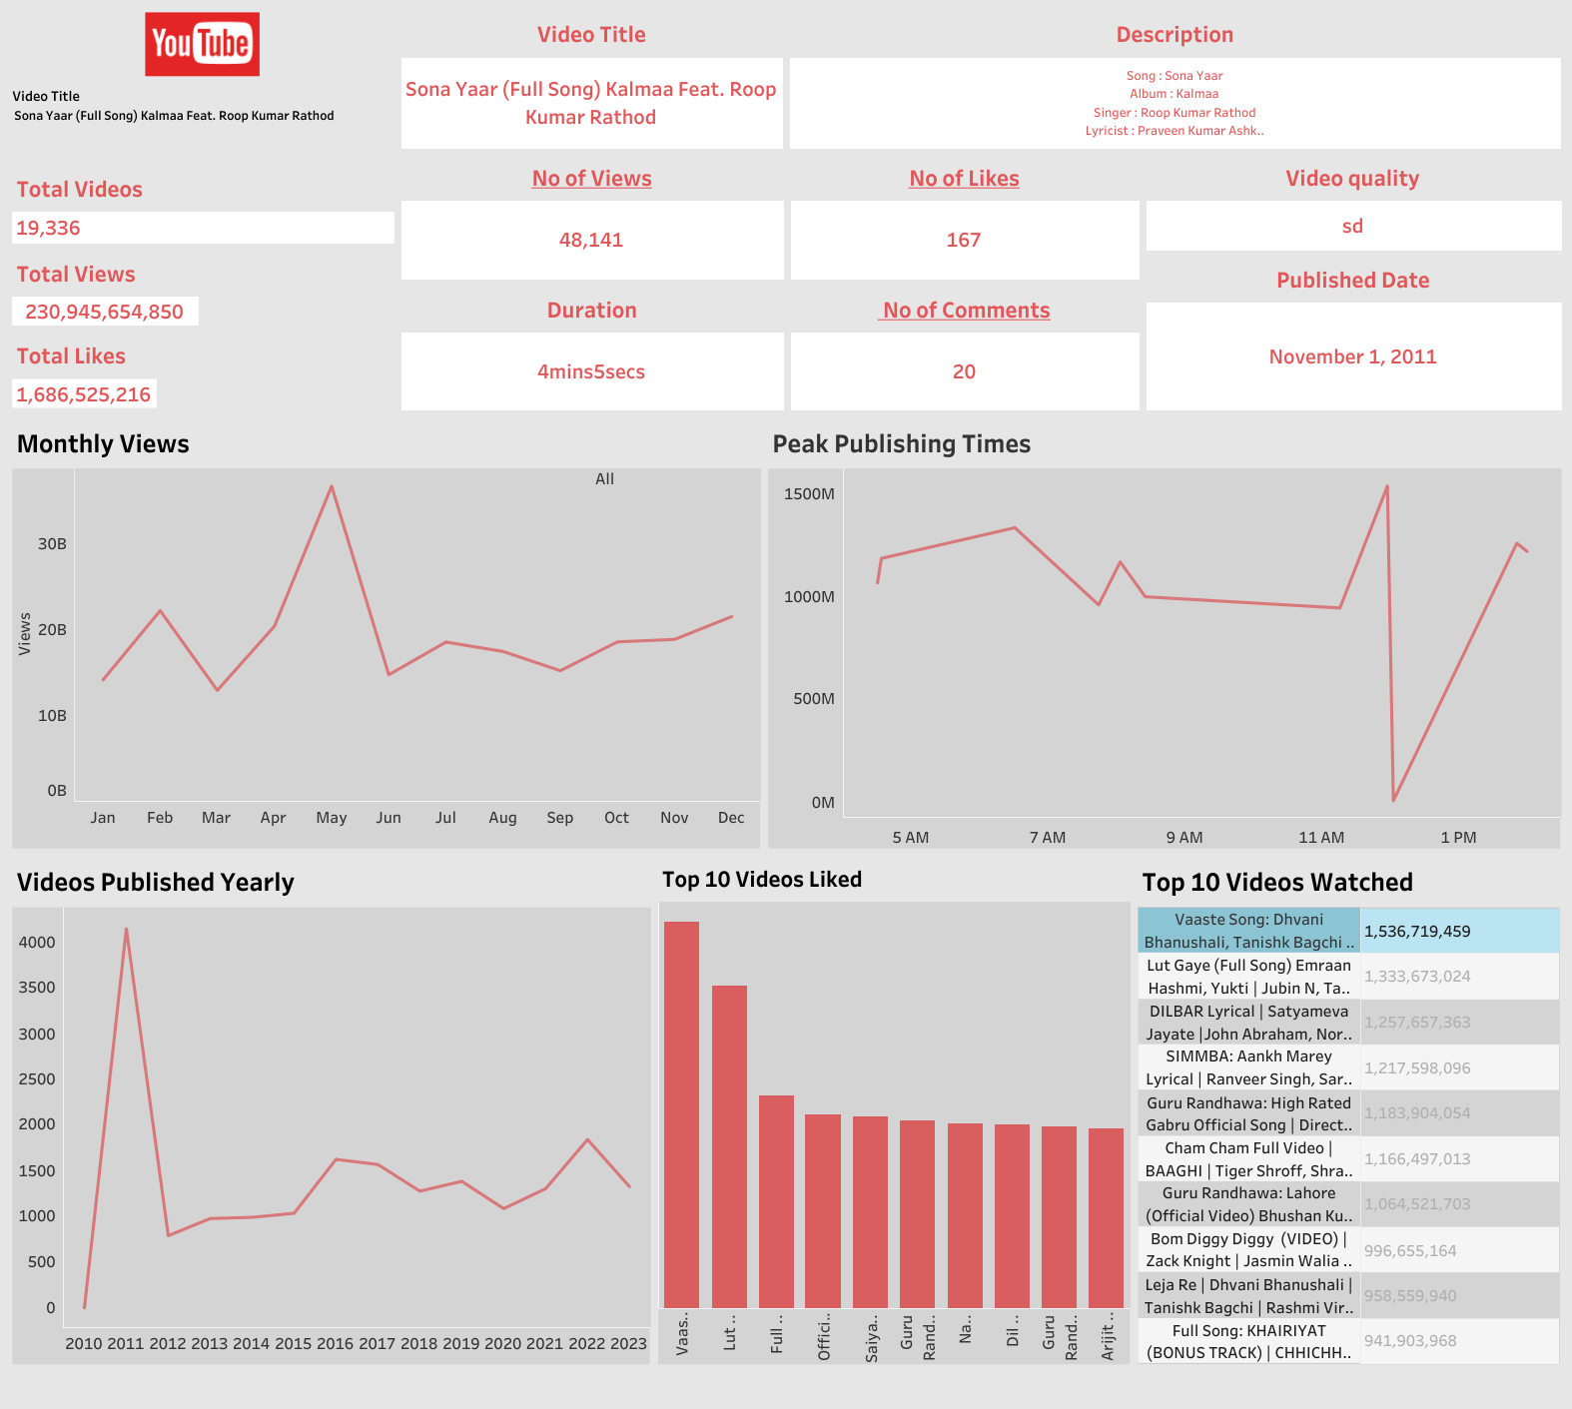

Slide 6
Key Findings
Most videos were published in the year 2011. Since then no number of videos published has been up to half the number of videos published in 2011.
The “Vaaste Song: Dhvani Bhanushali, Tanishk Bagchi | Nikhil D | Bhushan Kumar | Radhika Rao, Vinay Sapru” video is the most watched with a total of over 1.5Billion views
The “Vaaste Song: Dhvani Bhanushali, Tanishk Bagchi | Nikhil D | Bhushan Kumar | Radhika Rao, Vinay Sapru” video is the most liked with over 12million likes
The month of May has the most number of views of over 36Billion views
Song videos published within the hours of 11am to 1am have more views than other time of the day
Song videos with the Tags #hindisongs tend to have more views
No song video was a favorite by any of the users
THANK YOU

